Slide 1




Wellness
Convinience
HealthCura.AI
Presentation
Your one stop healthcare platform
24
ONLINE
HOURS

Slide 2
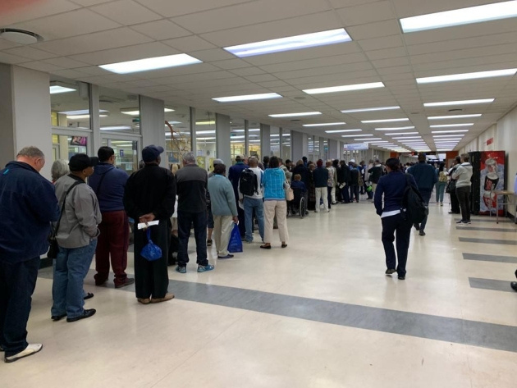



Problem Statement
Inconvenient Healthcare
Are South Africans getting the easy and convenient healthcare services they need?
Today getting medical help means going to different places for checkups, prescriptions, payment and medicine

Slide 3

2025
HEALTHCURA.AI to the rescue
HealthCura.Ai is a web-based premium healthcare platform that solves this by offering a one-stop digital platform that bring all these services together in one seamless, accessible solution.
Family-focused healthcare for all ages
Wellness
Convenience

Slide 4




HealthCura.Ai
Presentation
Wellness
Convenience
Unique Value Proposition
All in one platform
Leveraging AI
24/7 access to healthcare services

Slide 5

Target Market
R250 Billion Market Size
Our target market are:
Working Professionals
The Middle Class
The Upper Class
Medical Aid users

Slide 6





Marketing Activities
Digital Marketing Drive
Use social media platforms to promote our platform and practitioners
Use email marketing for personalised communication and discount offers

Slide 7

2025
HealthCura.Ai and Partners
Medirite, Dischem, Clicks
Private Practitioners
Council of Medical Schemes
HPCSA
Discovery Insurance

Slide 8
HC.AI
COST
REVENUE
Start-up cost of R150000:
We make money through fixeed commission:
App Development R100000
We have an average purchase order of R250
Branding R10000
7% on partner medical aid
15% commission on other medical aid purchases
Paid Meta ADs R10000
Search Engine Optimisation R30000
10% commission on cash purchases

Slide 9

Projection
What is our Aim in the next 12 months
Our projections are as follows:
20000 customers
R5 Million in sales
R1 million in commission and other fees
Nationwide reach
Break-even in 6 months

Slide 10

HealthCura.Ai
Presentation
Wellness
Convenience
OUR ASK
R330000
R100000 PCs and servers
R180000 rental space
R50000 cloud server

